Slide 1

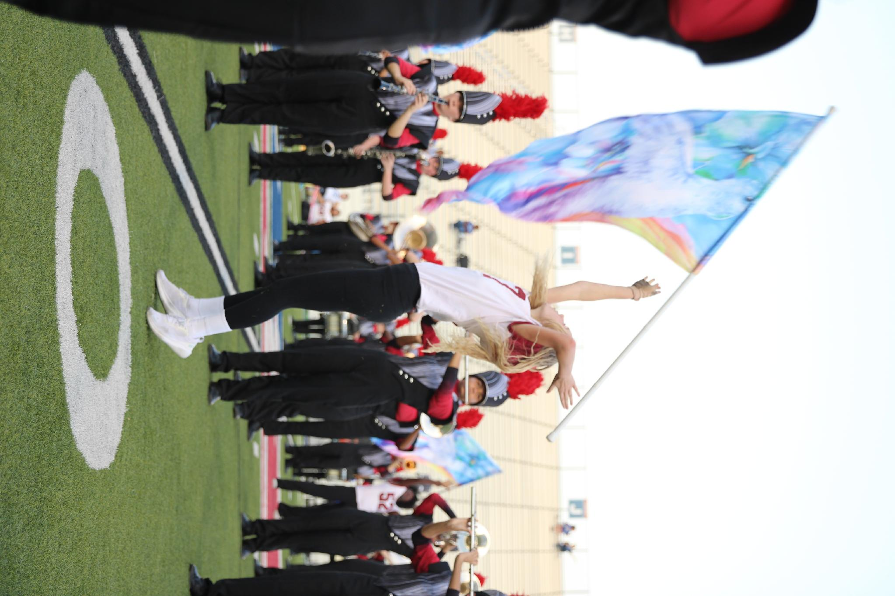
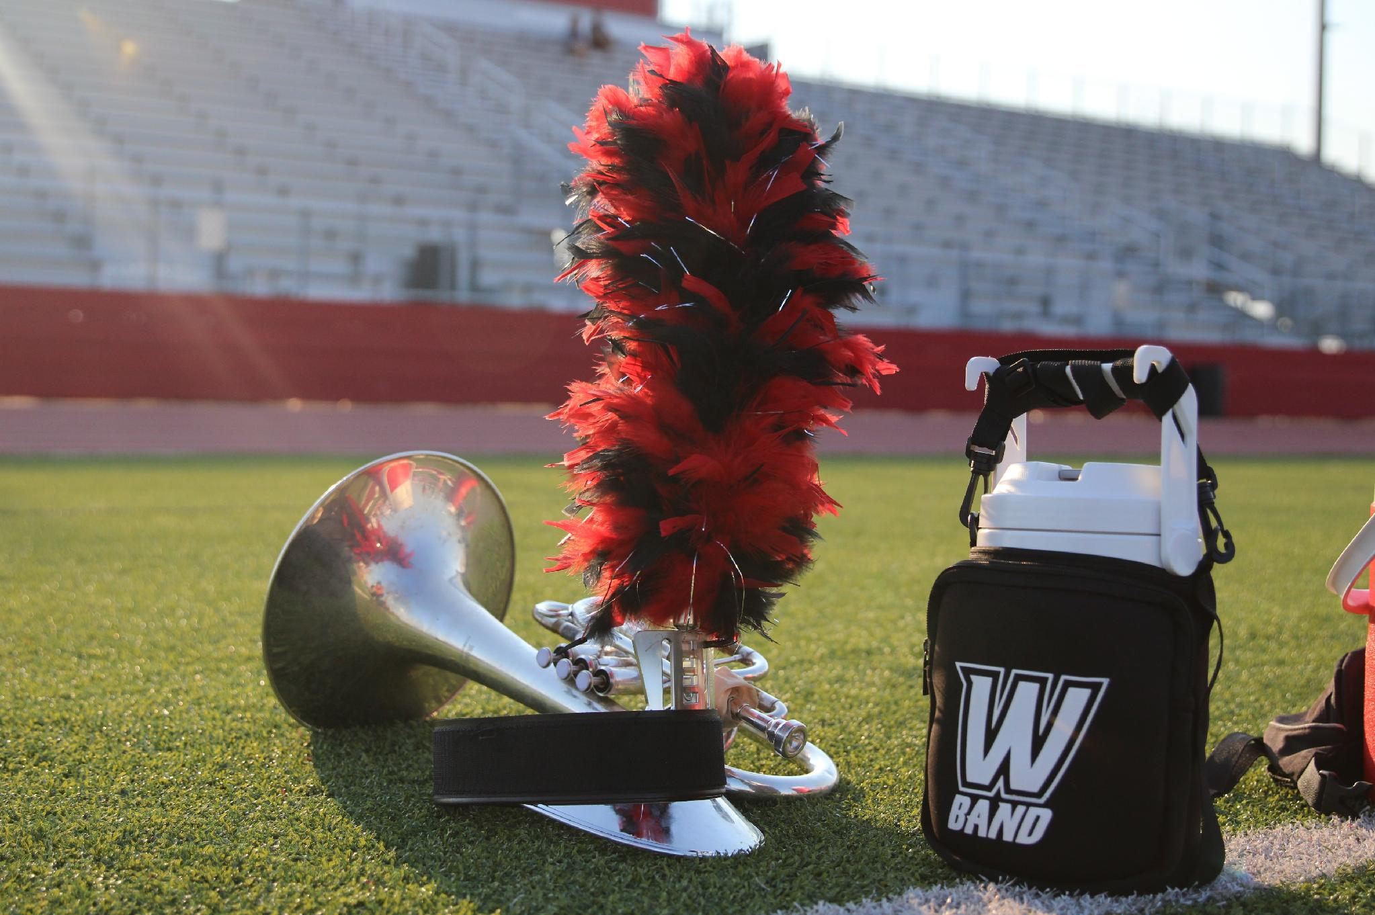

Weiss High School Band
Join the Pack. Build the Legacy.
26-27 Sponsorship Packages Opportunities
We foster selflessness, integrity, work ethic, teamwork, and perseverance through the power of music. Music is our tool to teach students traits to become positive, contributing members of society. Musical education and appreciation drives our collective success.
Our Mission

Slide 2
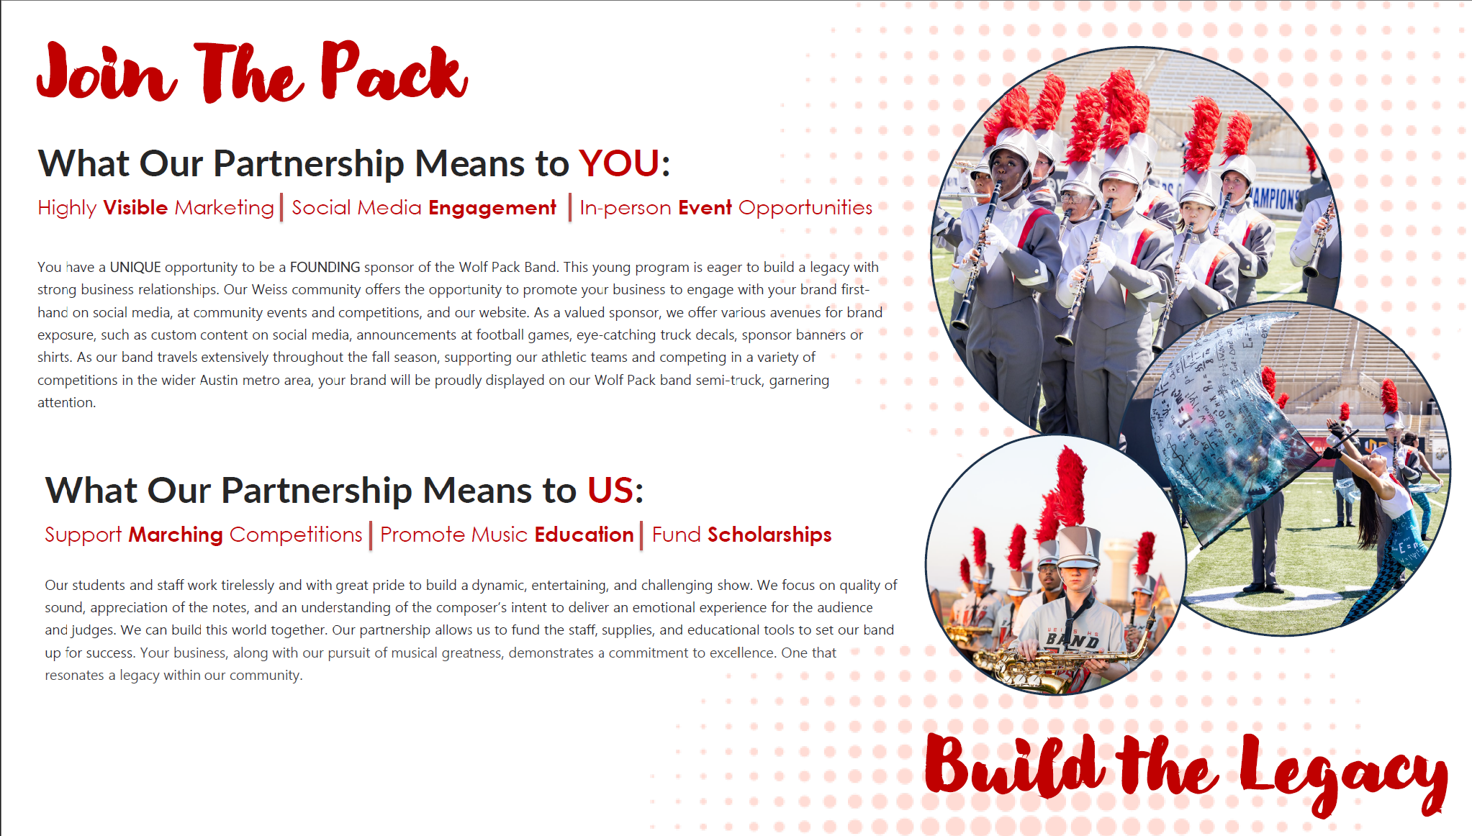
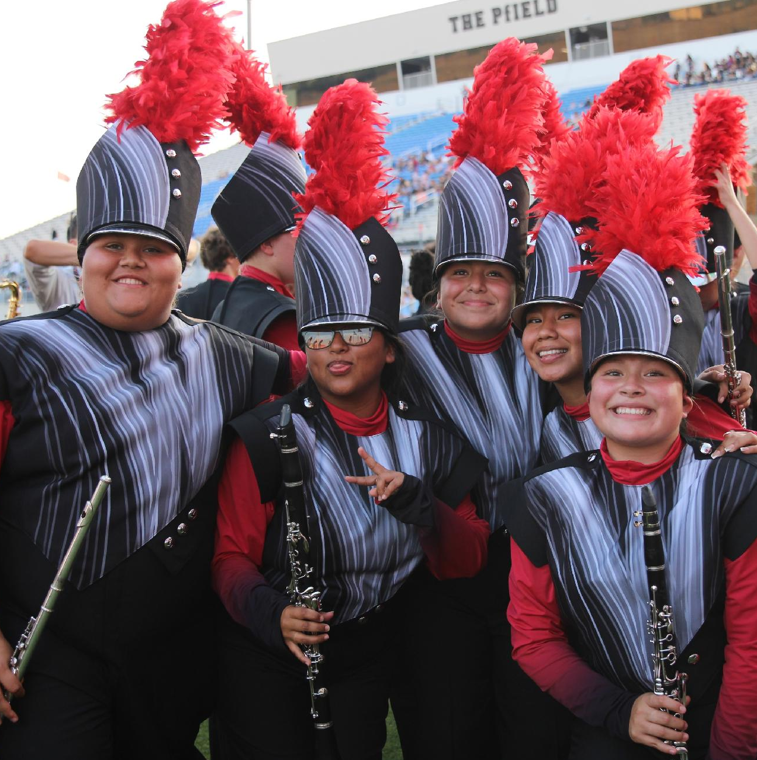
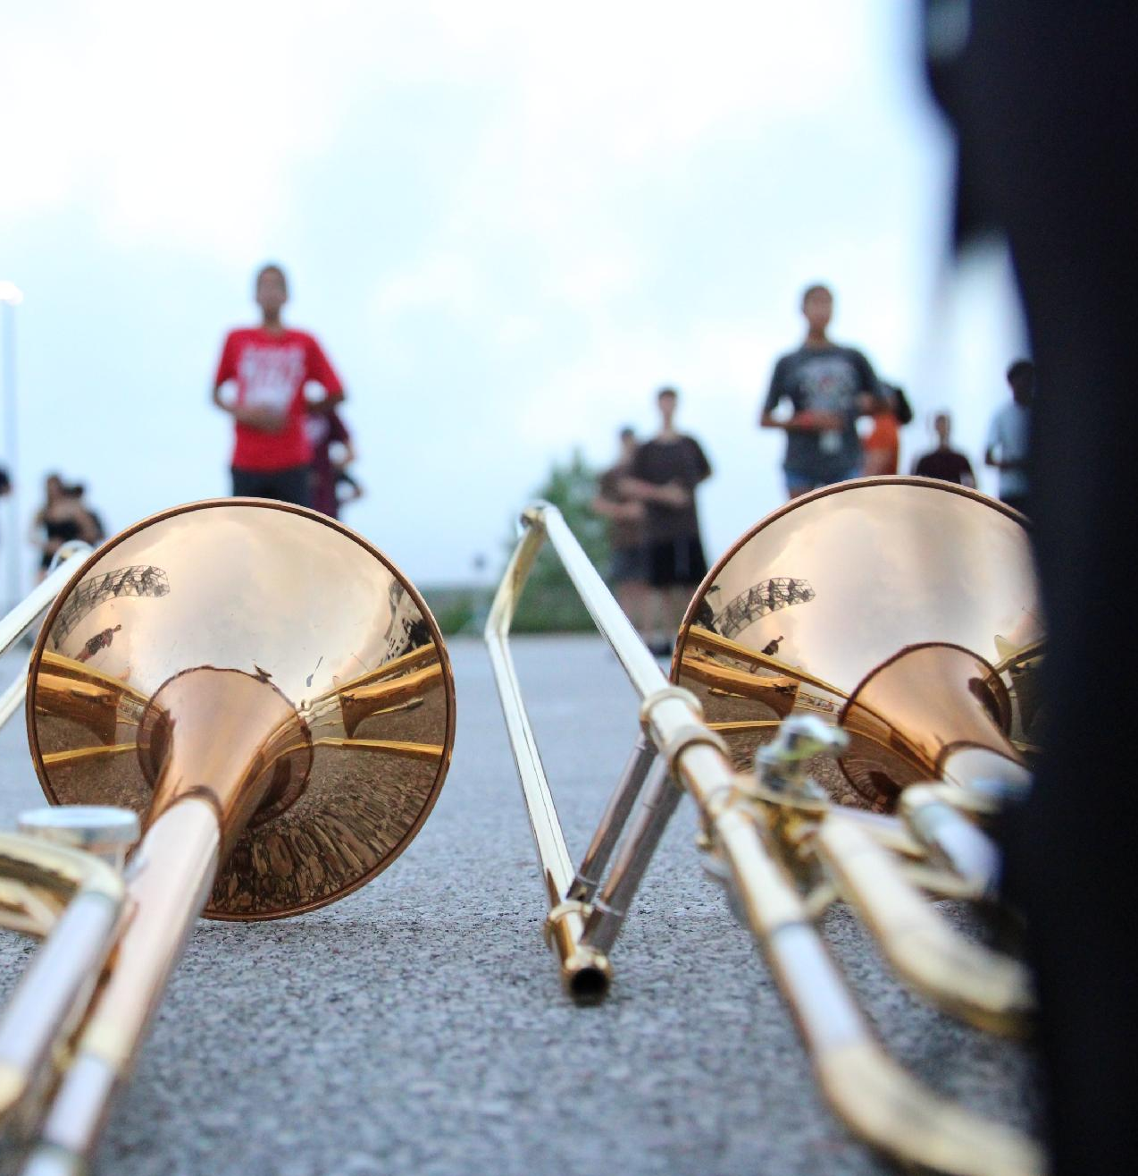
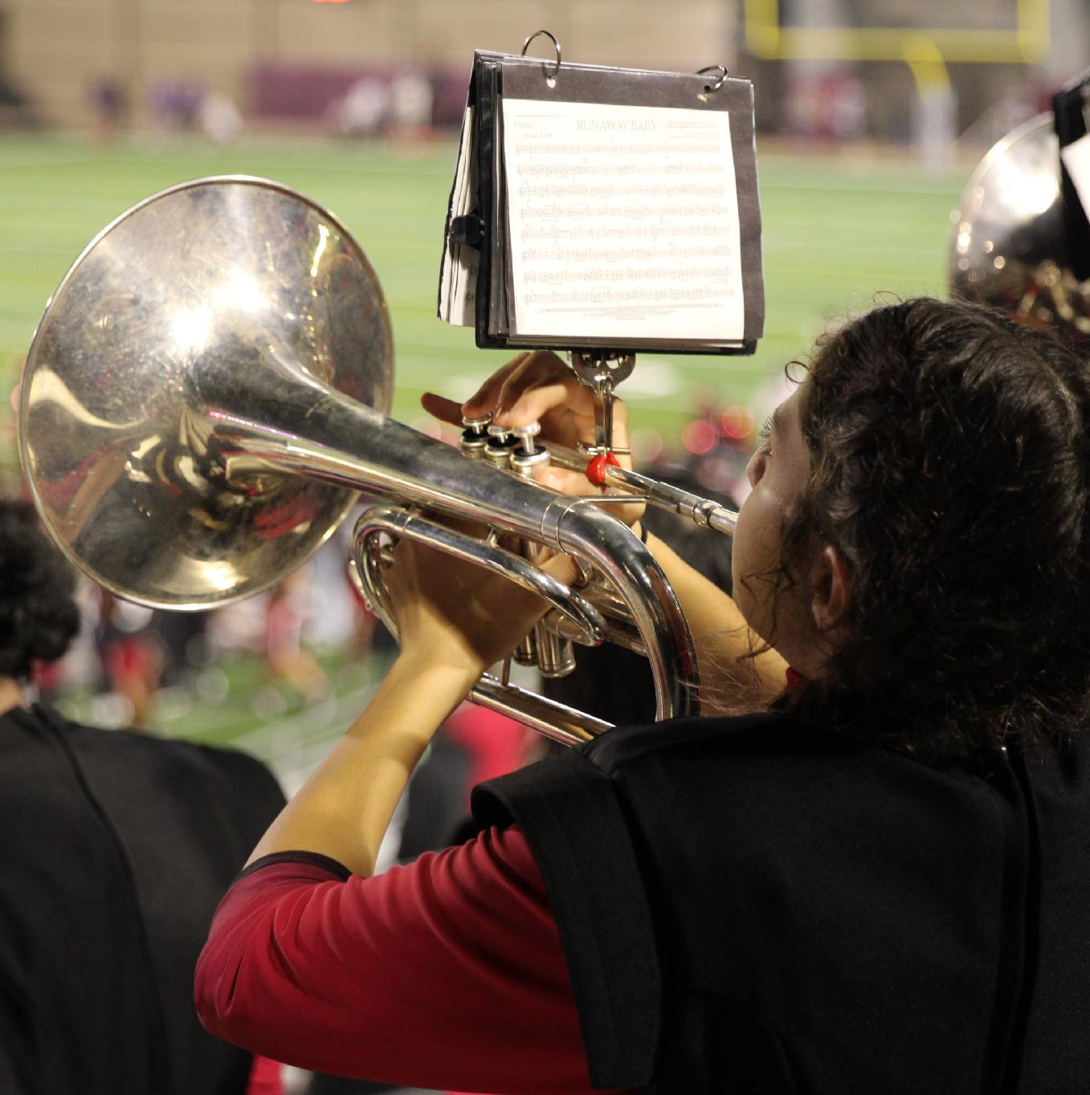

Slide 3
 | Supporter | Fan | Howler | Section Leader | Drum Major | Conductor
 | $250 | $500 | $1000 | $2000 | $3000 | $3500+
“I Support Wolf Pack Band” Yard Sign | x | x | x | x | x | x
Band Show T-Shirt |  | x | x | x | x | x
Weiss Band Swag Bag |  |  | x | x | x | x
Digital Marketing/Recognition
Website Linked to Business | x | x | x | x | x | x
Company name listing in band blast | x | x
Company logo in band blast |  |  | x | x
Email Blast to Band Booster Members |  |  |  |  | x | x
Social Media Call Out | x | x
Social media video thank you |  |  | x | x
Social media custom content (produced and approved by band director) |  |  |  |  | x | x
Concert Season (Dec-Apr)
Invitation to all concerts | x | x | x | x | x | x
Verbal thank you and slide recognition at beginning of concerts | x | x | x | x | x | x
Reserved seating at Winter and Spring Concert |  |  |  | x | x | x
Vendor table at Winter and Spring Concert |  |  |  |  | x | x
Marching Season
Reserved seating at Marching Season Community Preview Performance | x | x | x | x | x | x
Logo placement on game and semi-truck banner for 26-27 school year | x | x | x | x | x | x
Halftime Performance Call Out at Home Game |  |  | x | x | x | x
Premiere logo placement on game and semi-truck banner for 26-27 school year |  |  | x | x | x | x
Recognition as meal sponsor |  |  |  | x | x | x
Preferred seating with band at 1 home game of your choice |  |  |  |  | x | x
End of Year Band Banquet
Recognition at Band Banquets | x | x | x | x | x | x
4 Tickets to Annual Band Banquet |  |  |  | x | x | x
Pack Around the Park 5K Participation
Vendor Table at Pack Around the Park |  |  | x | x | x | x
Assistant Director Sponsor for Pack Around the Park |  |  |  | x | x | x
Title Sponsor for Pack Around the Park |  |  |  |  | x | x
Exclusive Offers
First Pick of Sponsorship for 27-28 |  |  |  |  | x | x
Section ensemble appearance at 1 company event (locally) |  |  |  |  | x | x
Custom Package Options Available |  |  |  |  |  | x
Sponsorship Packages

Slide 4
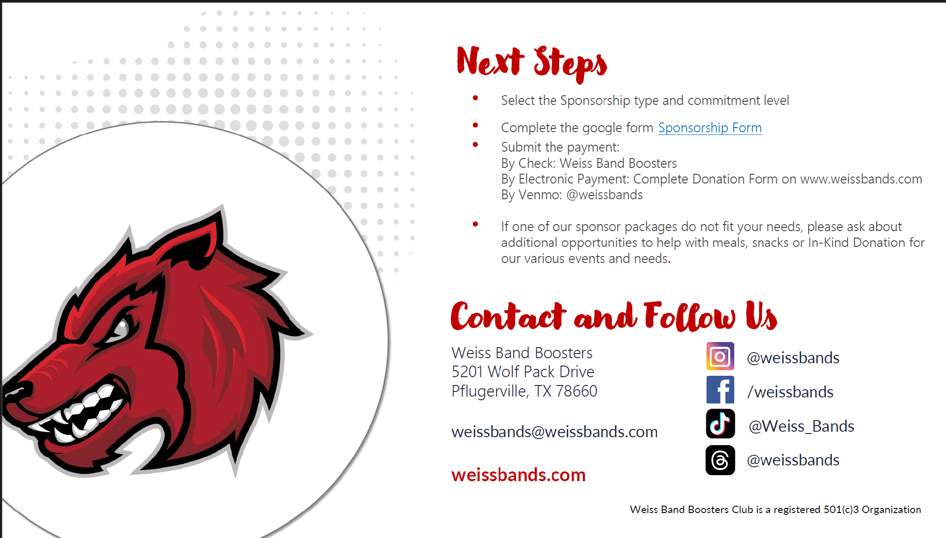
Select the Sponsorship type and commitment level
Complete the google form: Sponsorship Form
Submit the payment:
By Check: Weiss Band Booster Club
By Electronic Payment: Complete Donation Form on www.weissbands.com
By Venmo: @weissbands
If one of our sponsor packages do not fit your needs, please ask about additional opportunities to help with meals, snacks or In-Kind Donation for our various events and needs.

